Slide 1
Software-in-the-Loop Simulation of UAV-UGV Co-operation in Precision Agriculture
Saron Bhoopathy¹,
Kenta Hirashima², Varun Aggarwal¹, Aanis Ahmad¹,
Dr. Dharmendra Saraswat¹
¹Purdue University
²University of Illinois Urbana-Champaign

Slide 2
Motivation and Introduction: What is Precision Agriculture and why do we need it?

Slide 3
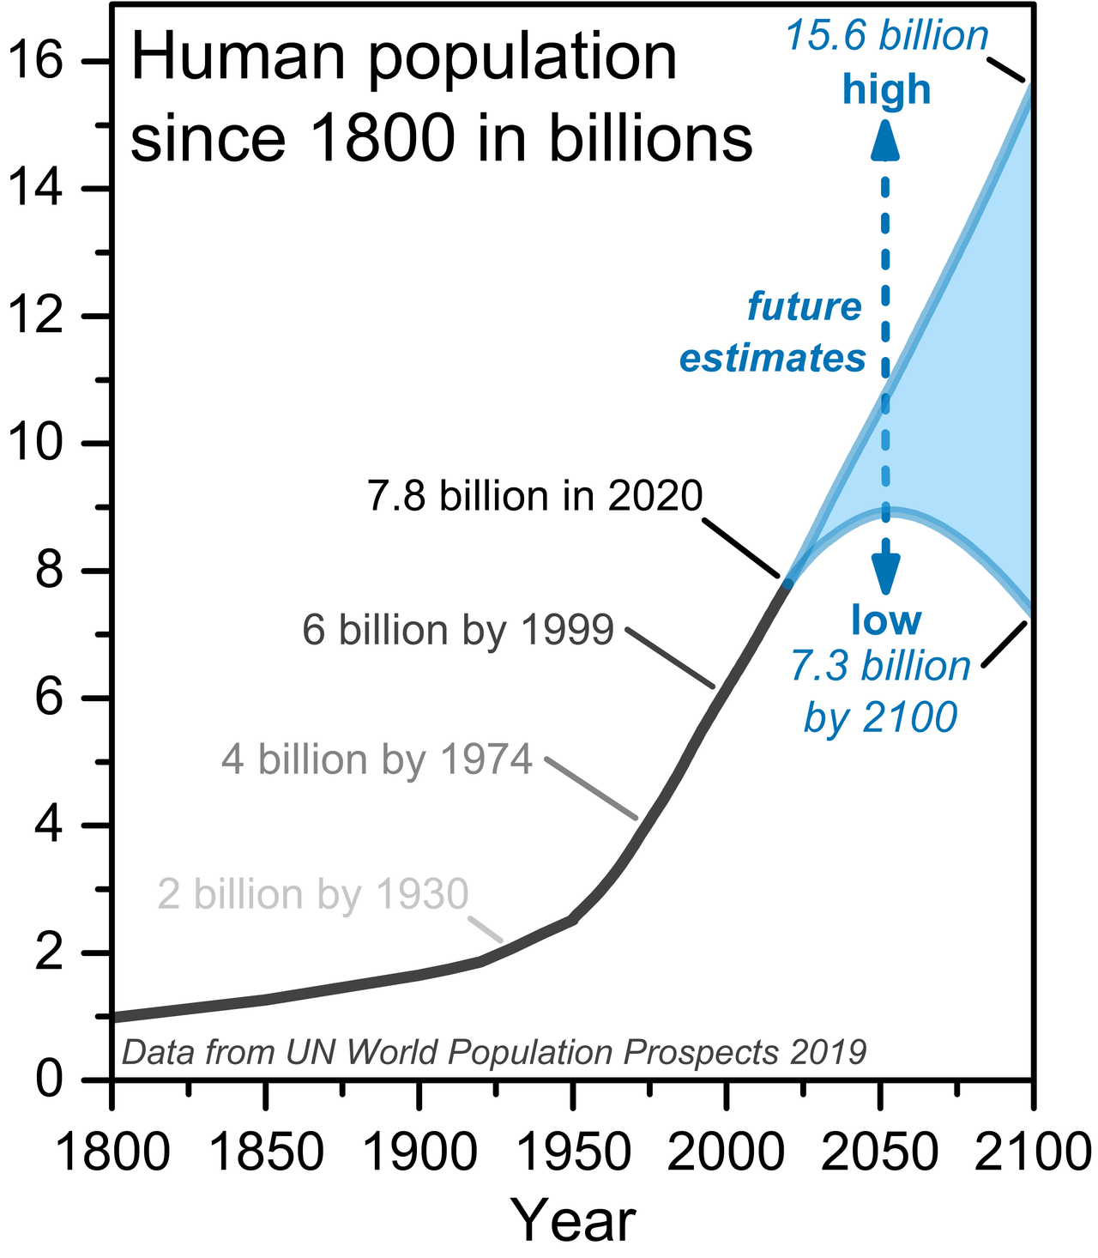
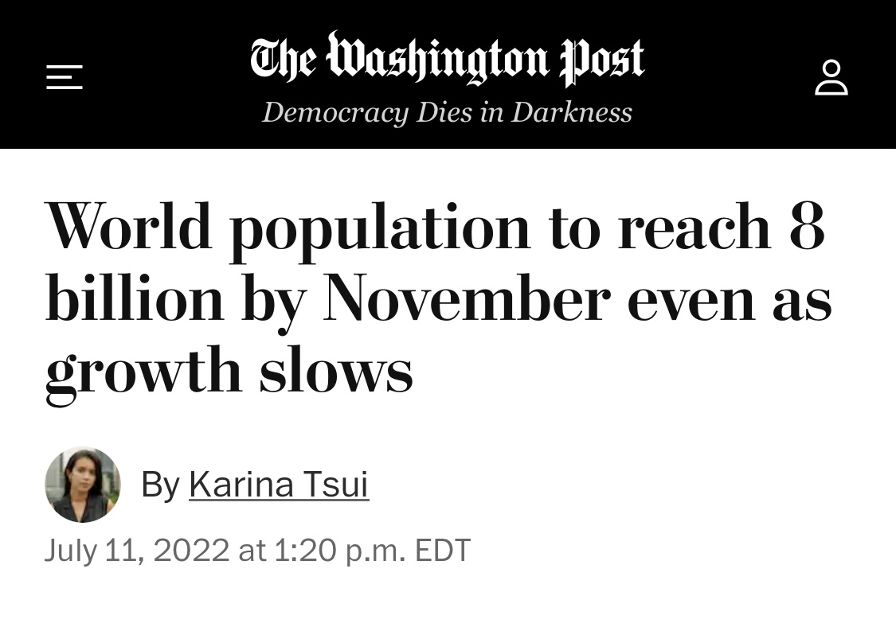
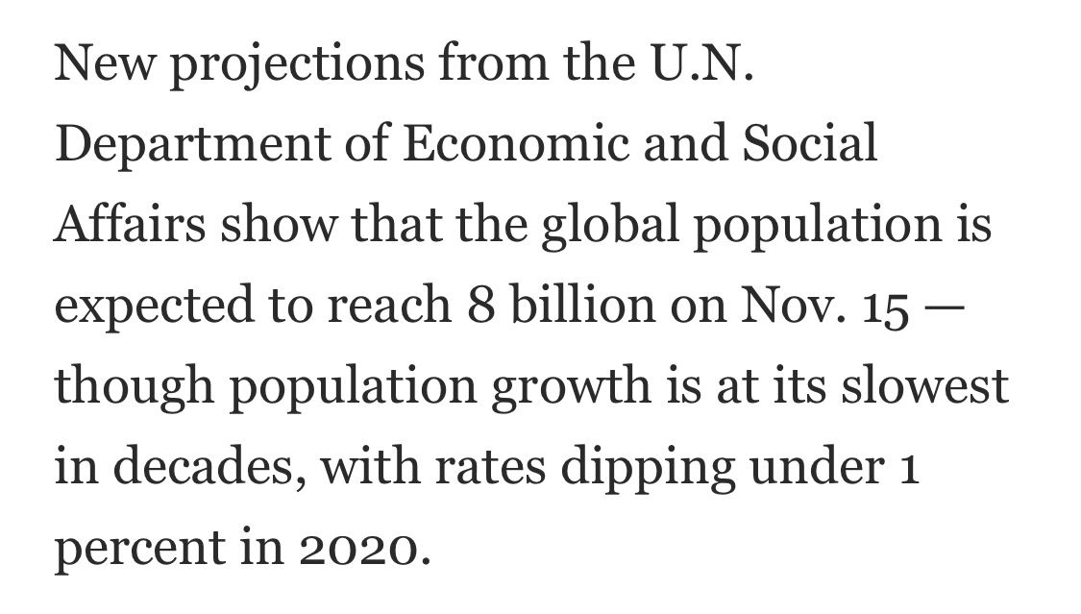
Need to Feed Current and Future Populations

Slide 4
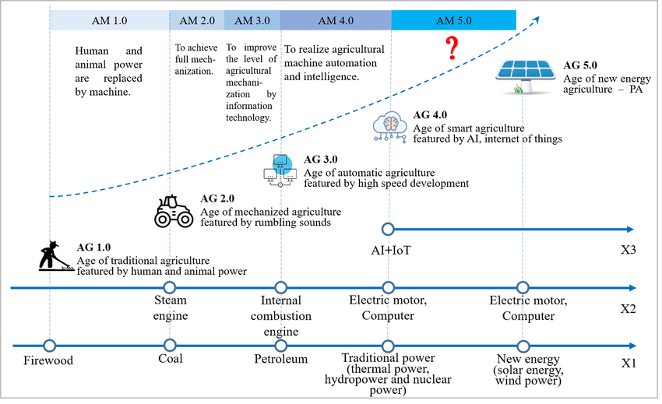
Agriculture Has Transformed Human History

Slide 5
In order to sustain current and future populations, we need to optimize farming practices.

Slide 6
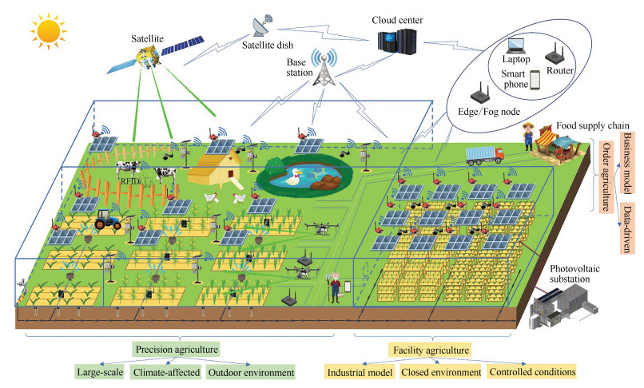
Precision Agriculture in the Agriculture 4.0 Model

Slide 7
Overview of Proposed UAV-UGV Co-operative System in Corn Field

Slide 8
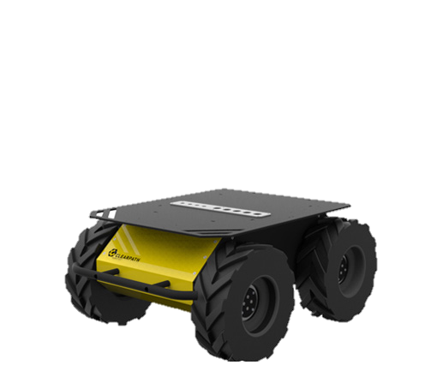
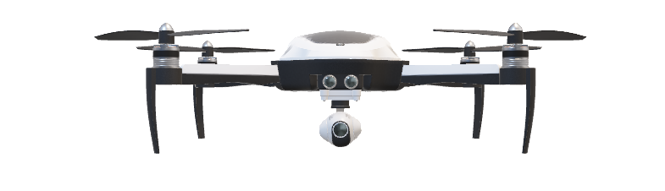
UAV surveys corn field

Slide 9
Target crop of interest

Slide 10
UAV identifies target of interest using computer vision

Slide 11

UAV communicates target co-ordinates to UGV

Slide 12

UGV moves to published co-ordinates

Slide 13

UGV performs required task on target of interest

Slide 14
Problem statement: We need a simulation package to test UAV and UGV systems that communicate and co-operate in farming applications.

Slide 15
Methods and Materials: How did we develop the Software-in-the-Loop (SITL) Simulation?

Slide 16
How do we establish control for UAV and UGV? We need a flight computer and flight control software

Slide 17
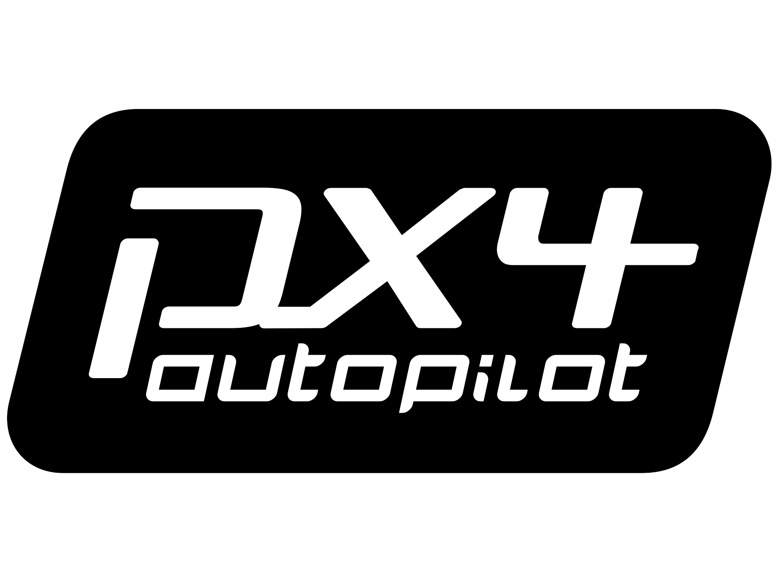

Open Source PX4 Autopilot and Pixhawk Flight Controller
Image source: PX4 documentation

Slide 18
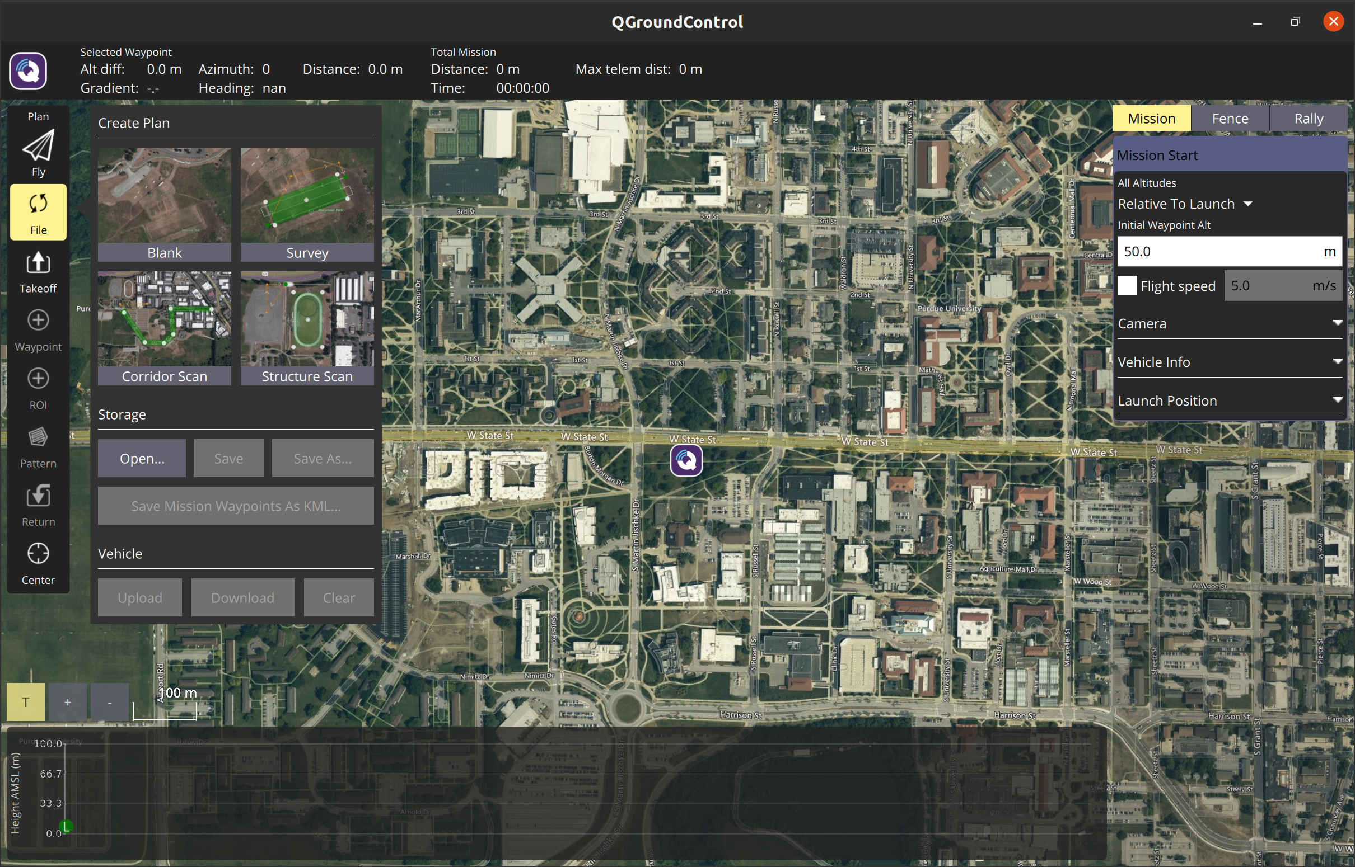
Ground Control Station: QGroundControl (QGC)

Slide 19
We need a simulation environment that accurately models physics so we can test our system.

Slide 20
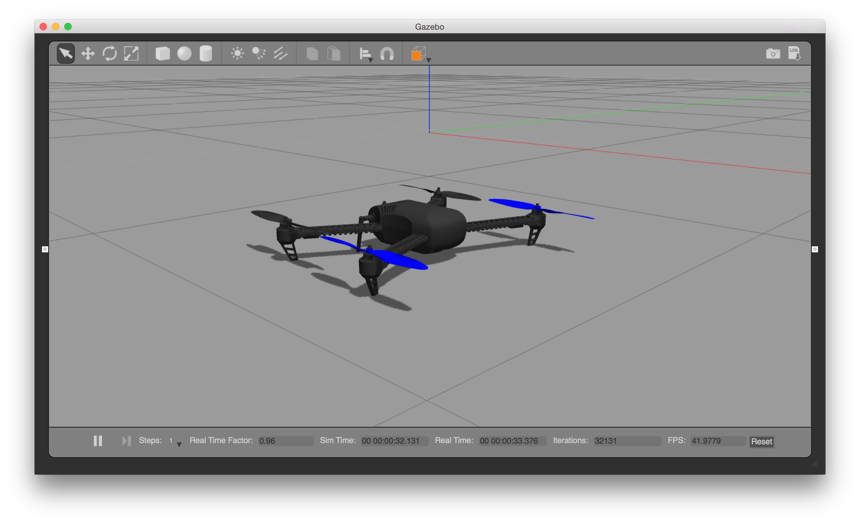

Gazebo Simulation Environment for SITL to Test System Mechanics and Physics
Source: Gazebo docs and PX4 docs

Slide 21
How do we model a PX4-Based vehicle for SITL Simulation in Gazebo?

Slide 22
PX4-Autopilot
Tools/sitl_gazebo/models/
model.config
------ Create config file
matrice_600.sdf
------ Create sdf file
meshes
------ Include directory for model meshes
ROMFS/px4fmu_common/init.d-posix/airframes/
4230_matrice_600
------ Create airframe file
CMakeLists.txt
Platforms/posix/cmake/
sitl_target.cmake
------ Edit and add model name

Slide 23
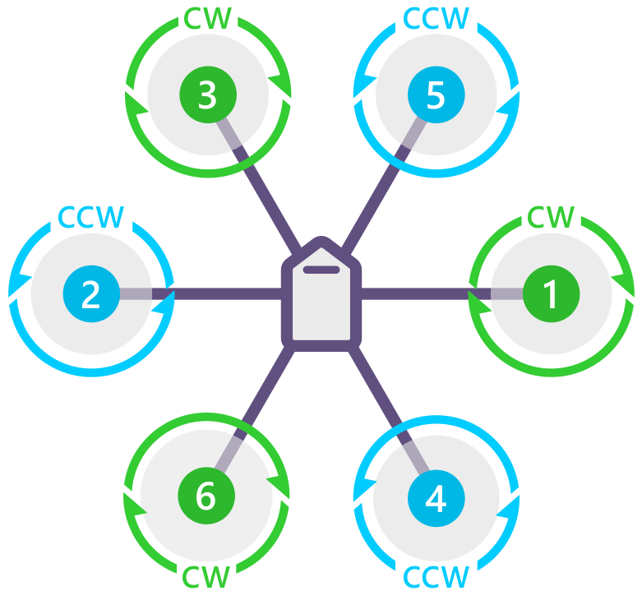
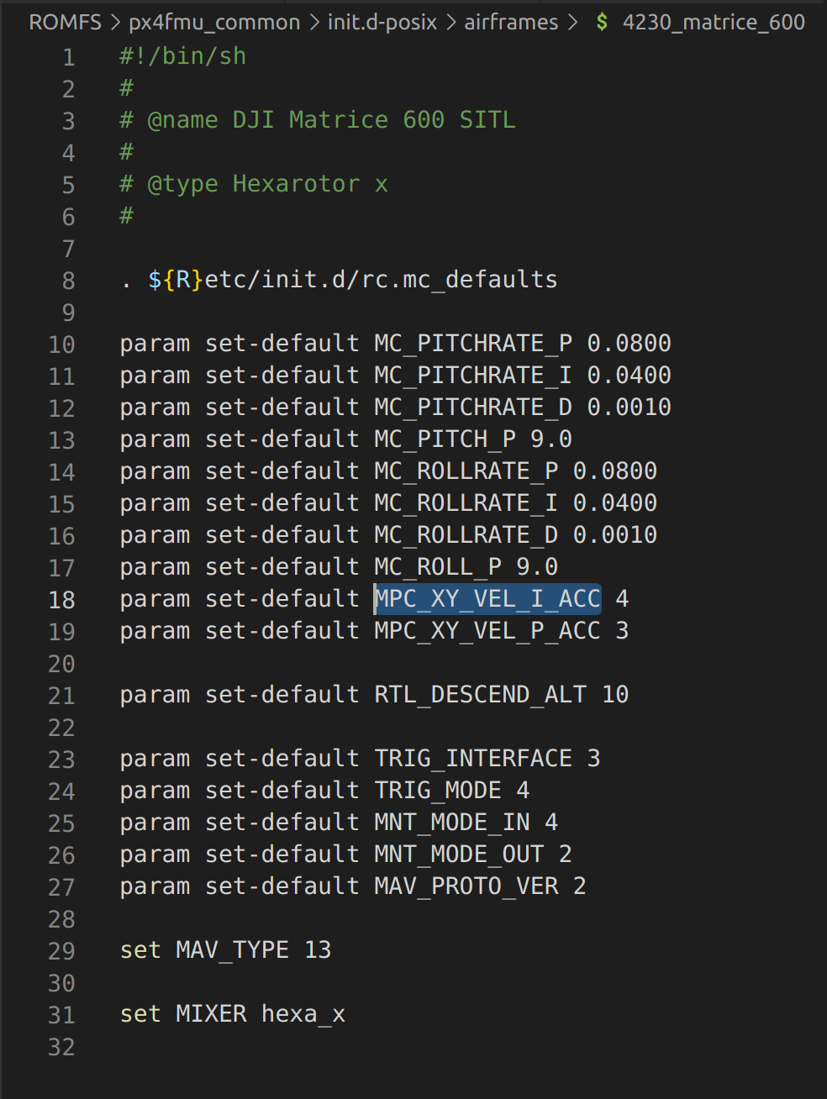
Modelling hexa-copter dynamics
Hexa propeller dynamics
Airframe file
Image source: PX4 documentation

Slide 24
How do we integrate flight controller with flight computer?

Slide 25


Robot Operating System 2 (ROS 2) Software Framework
Image source: Open Source Robotics Foundation (OSRF)

Slide 26
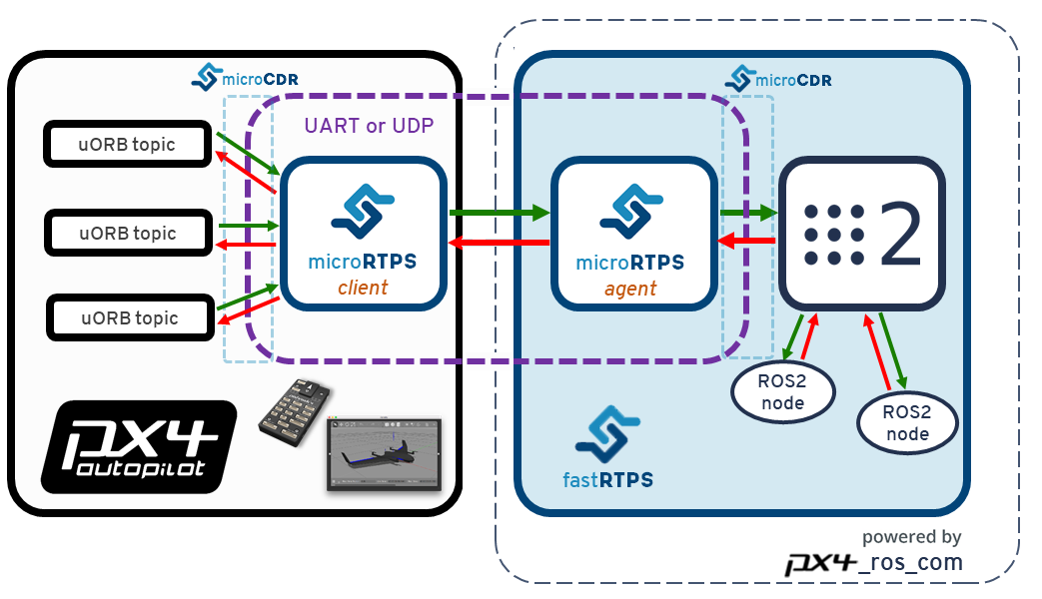
Overview of PX4-ROS2 Bridge: How we integrate PX4 and ROS2
Image source: PX4 documentation

Slide 27
In order to detect targets of interest, we need an object detection algorithm.

Slide 28
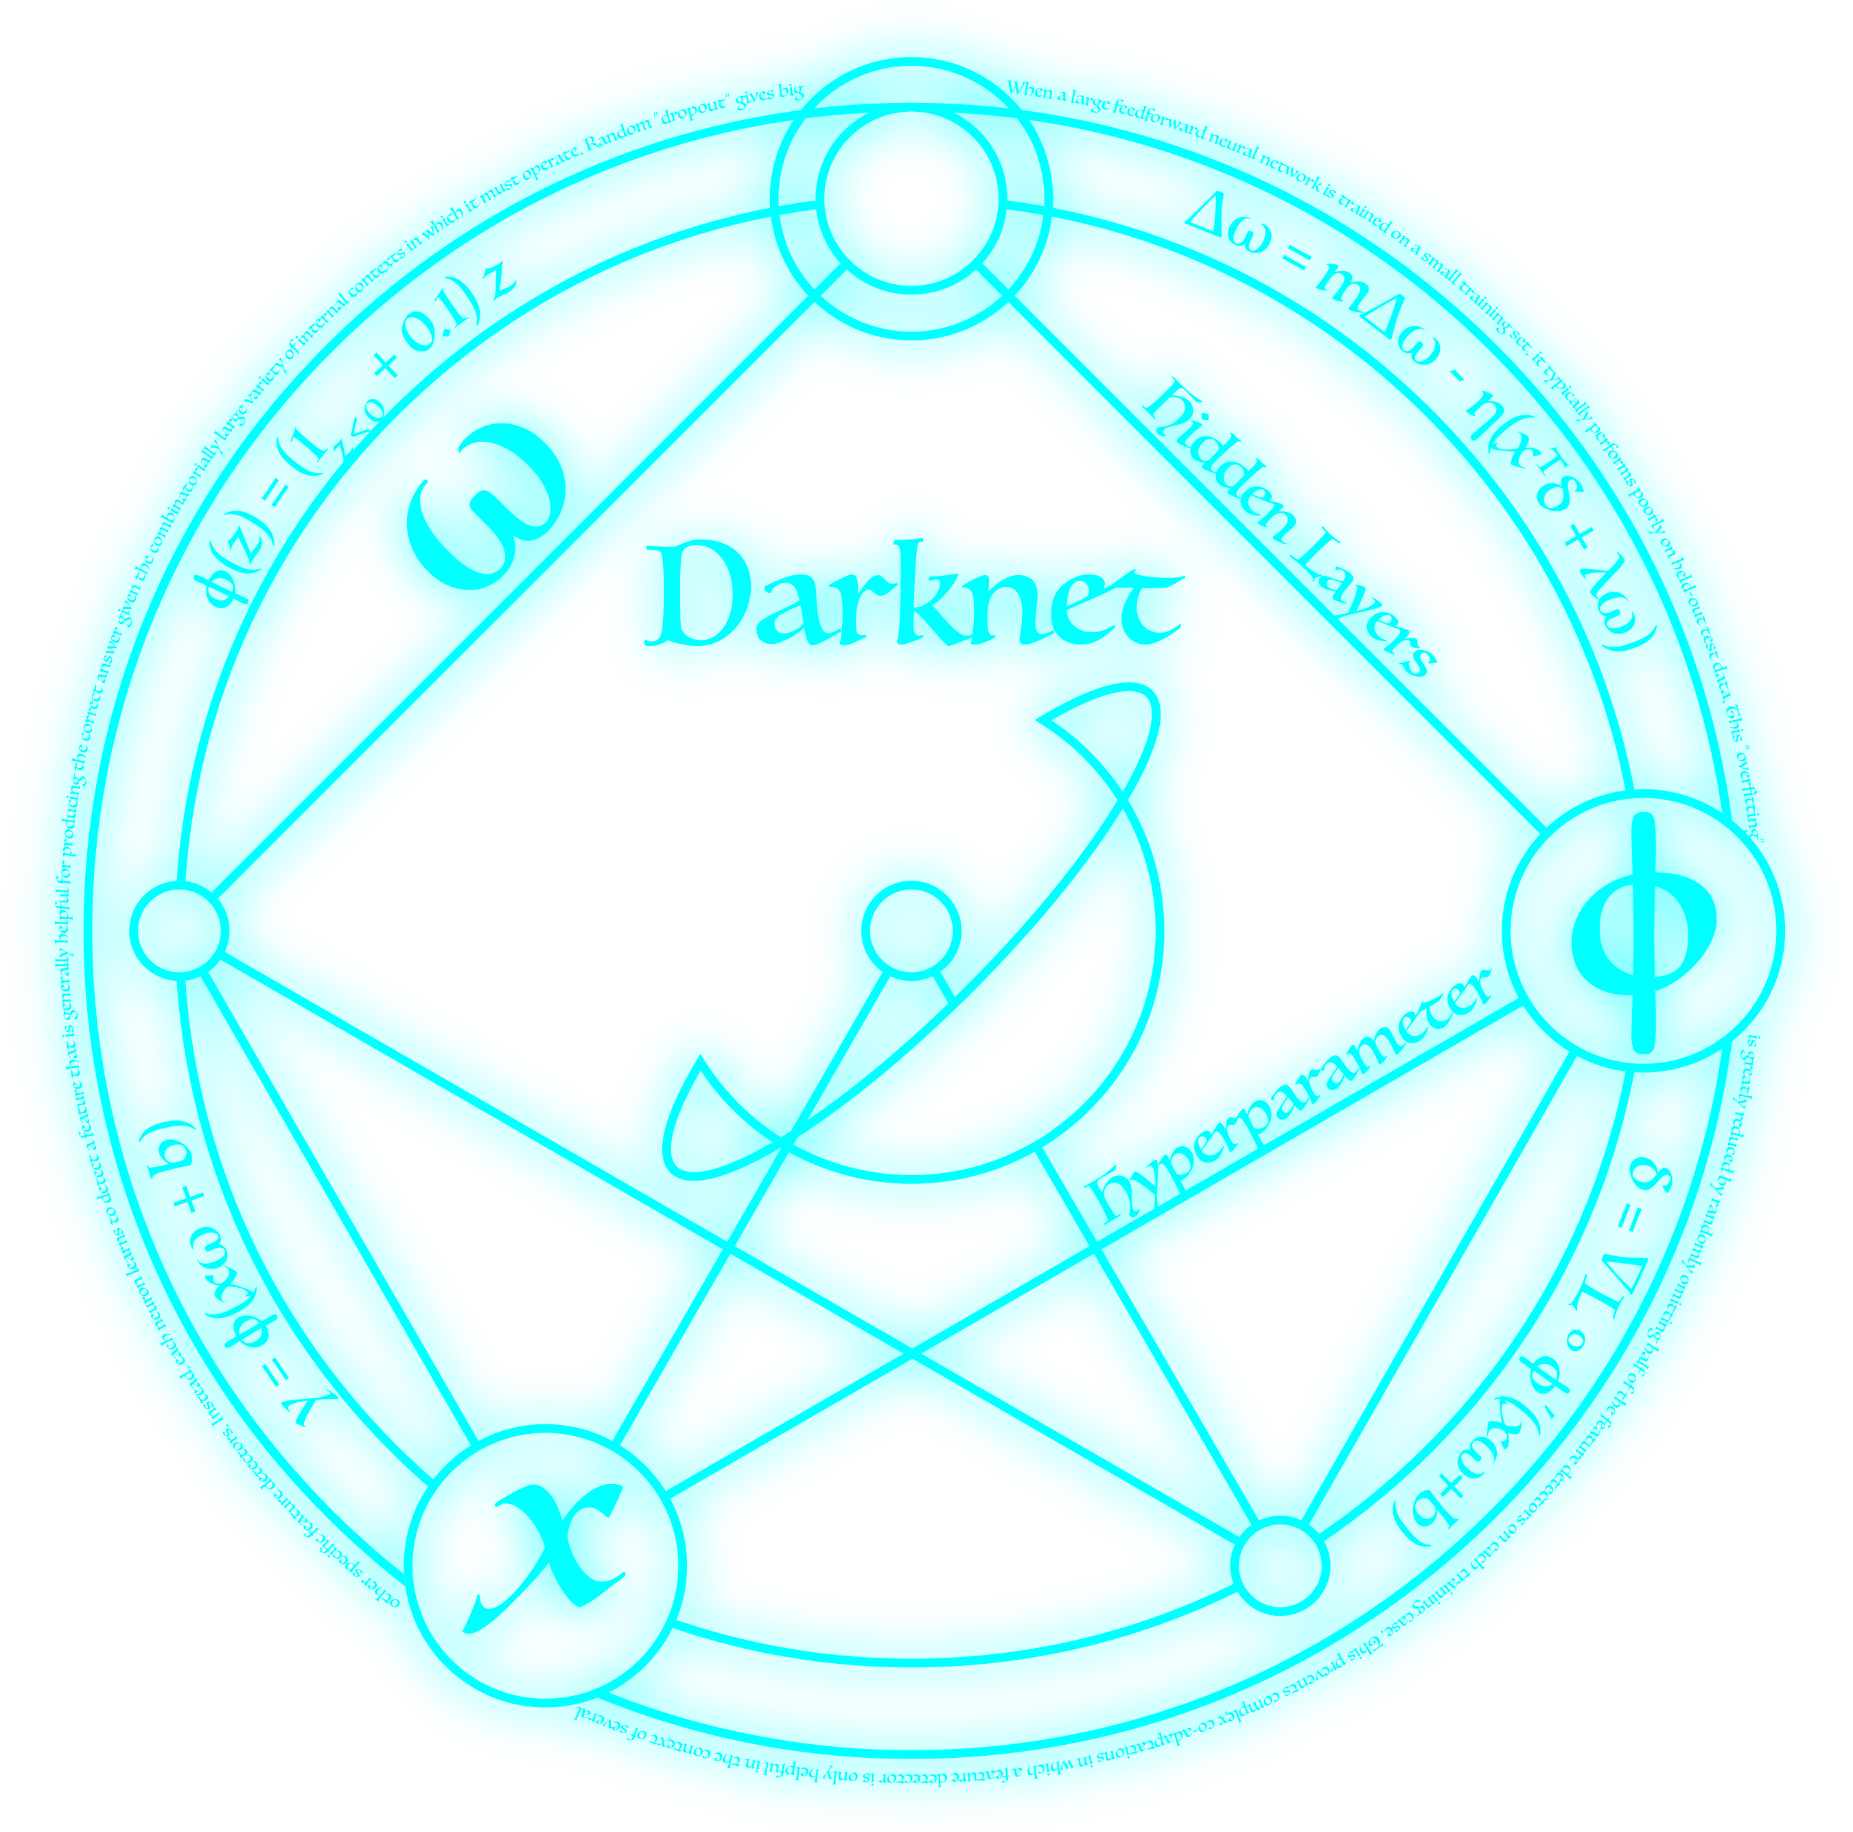

You Only Look Once (YOLOv3) Object Detection Algorithm
Image source: Joseph Redmon

Slide 29
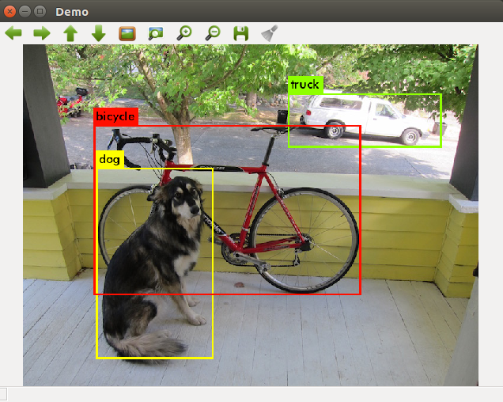
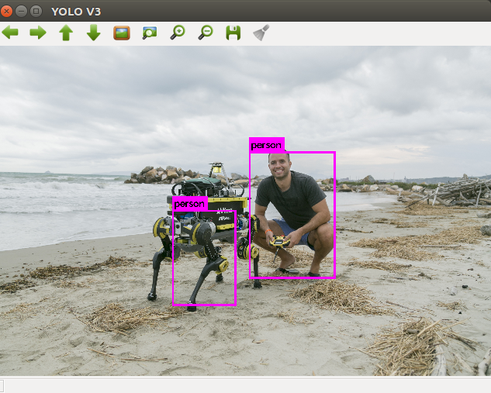
You Only Look Once (YOLOv3) Object Detection Algorithm
Image source: Joseph Redmon

Slide 30
Results: What did we develop and how does it function?

Slide 31
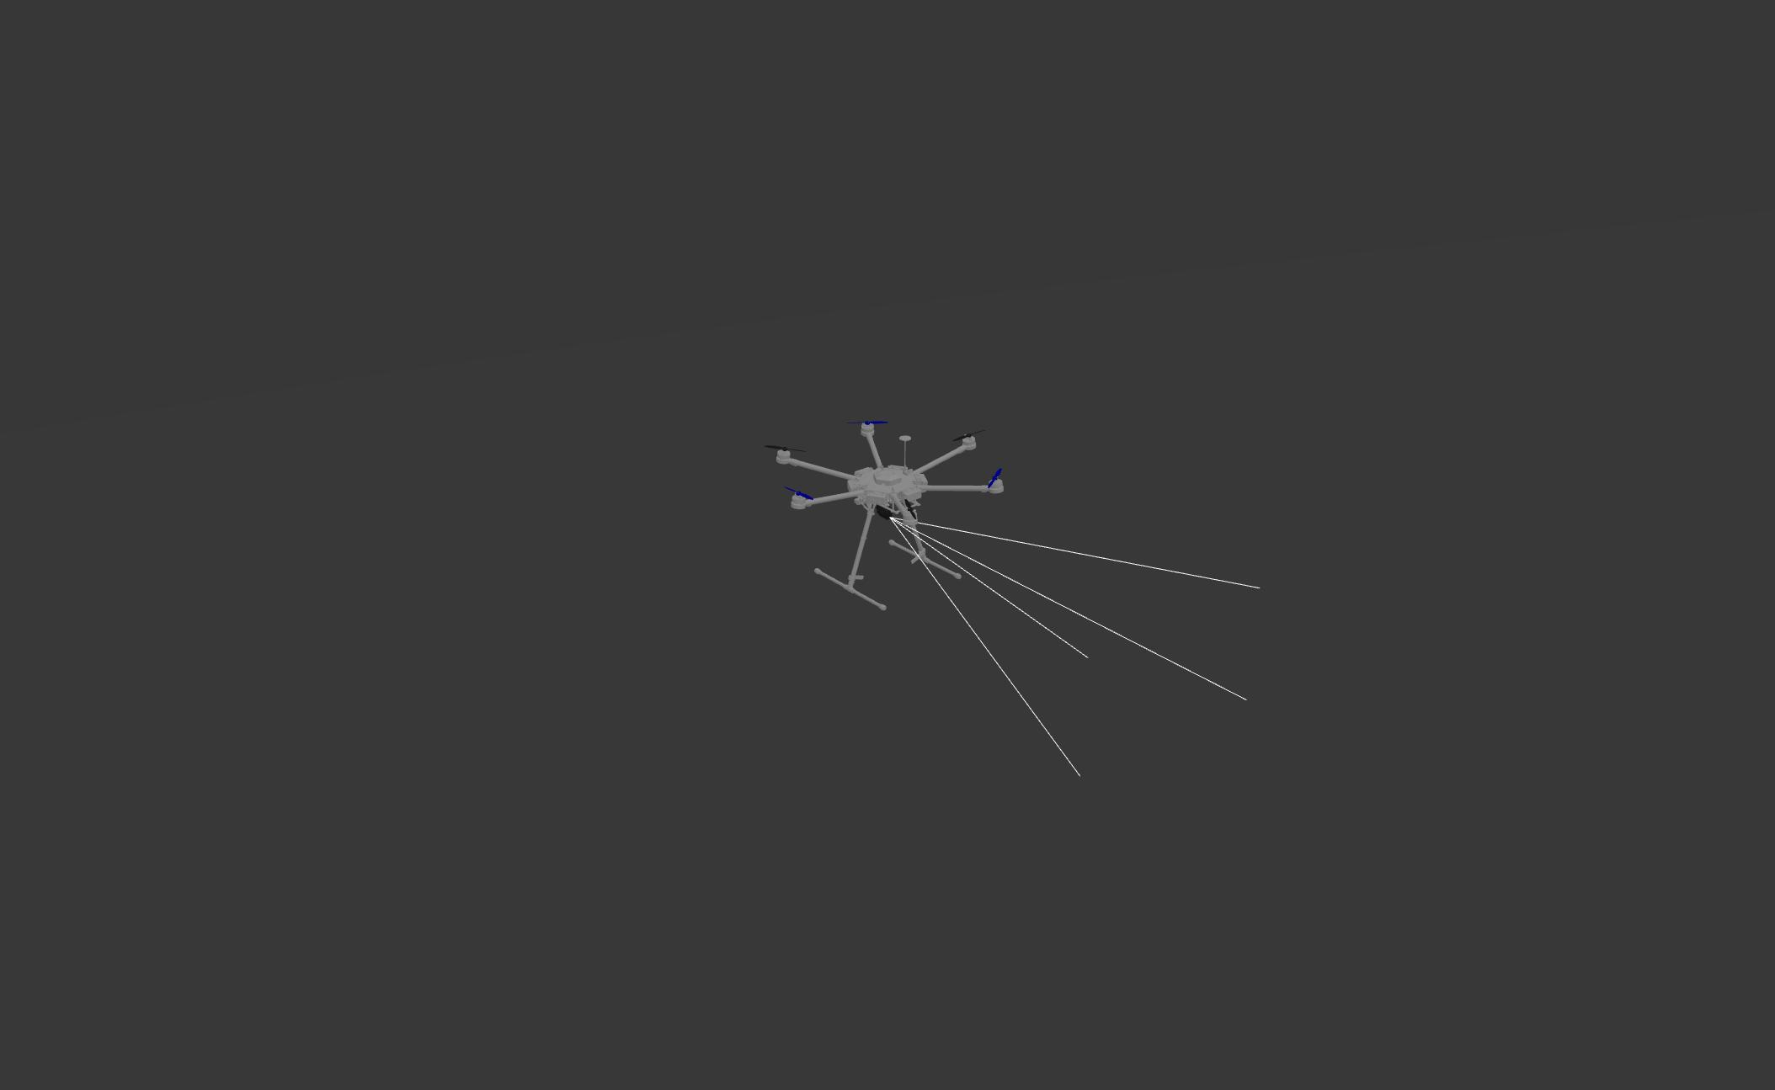
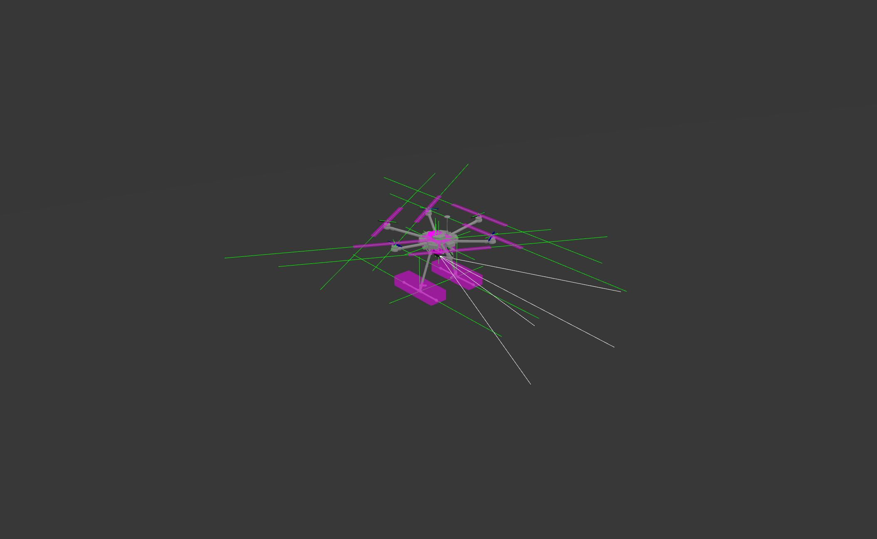
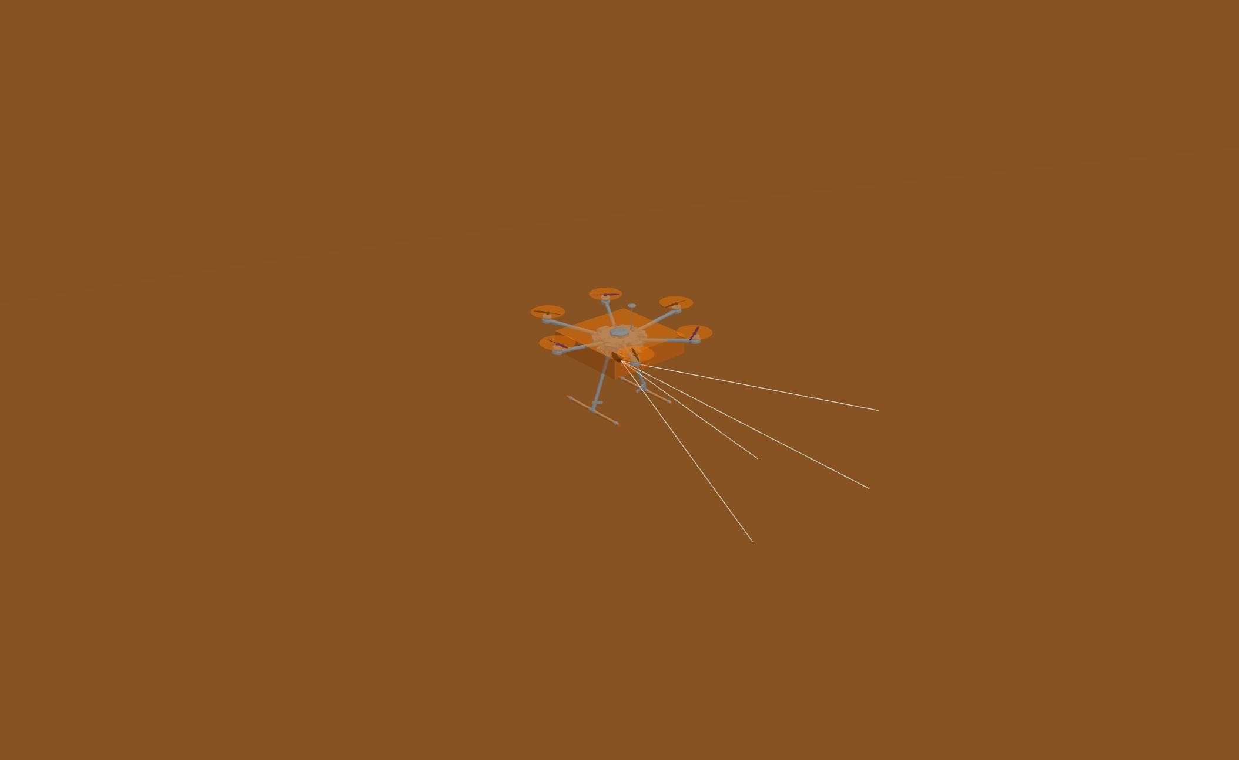
DJI M600 Model Construction in Simulation Description Format (SDF)
DJI M600 Model
Inertial overlay
Collision overlay

Slide 32
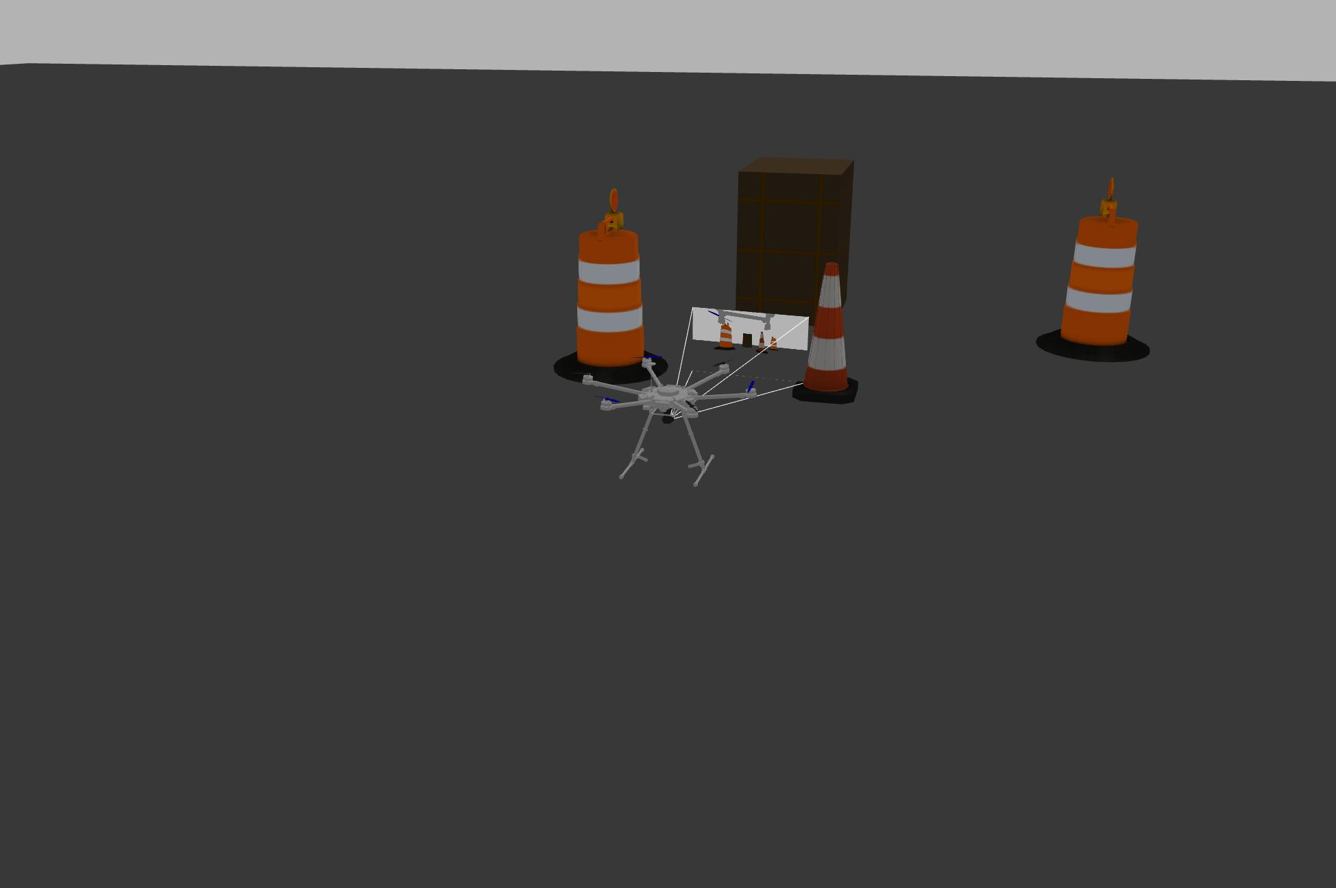
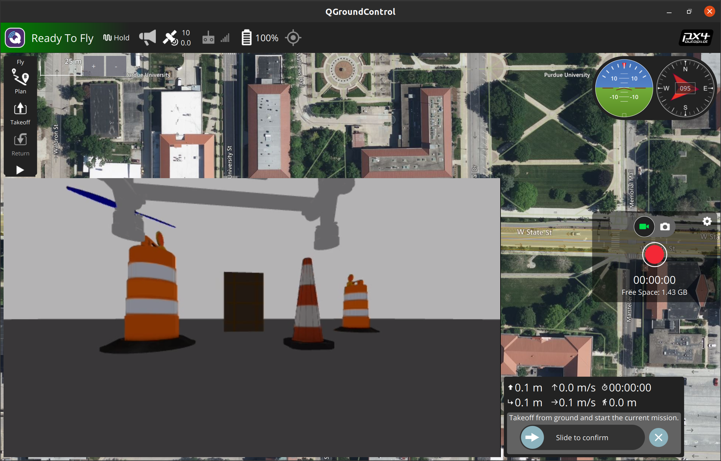
Live stream from Gazebo simulated world to QGC
Gazebo simulated world
Livestream from simulation to QGC

Slide 33
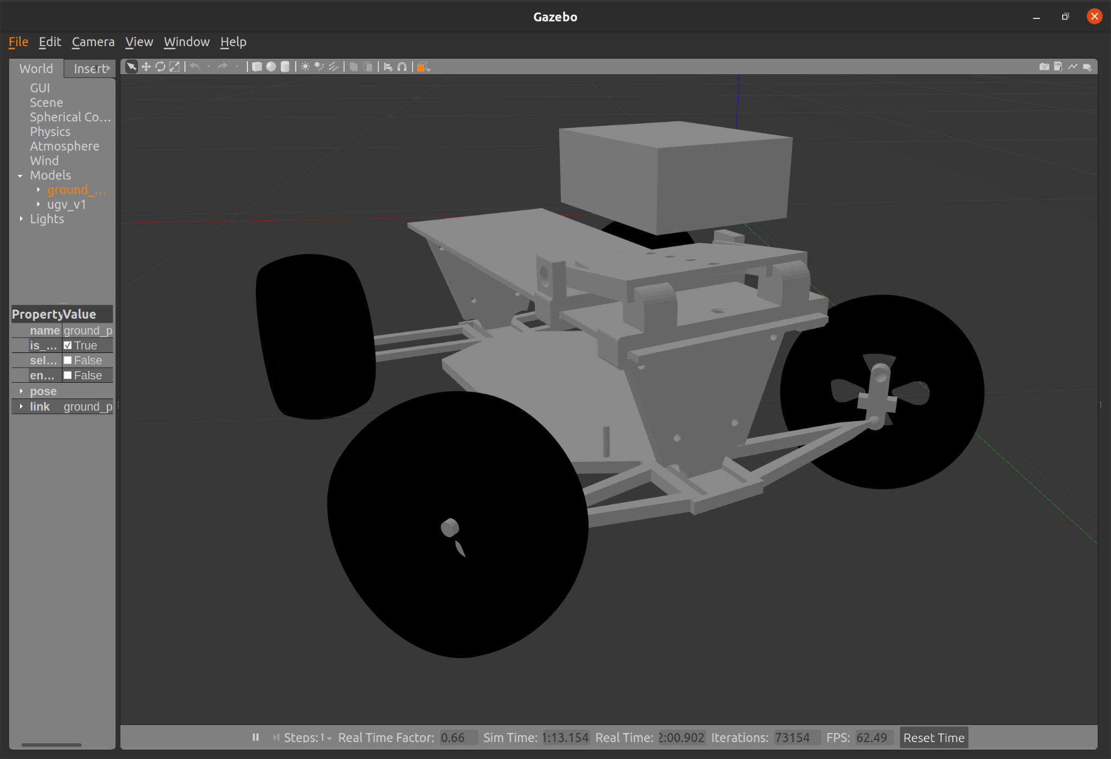
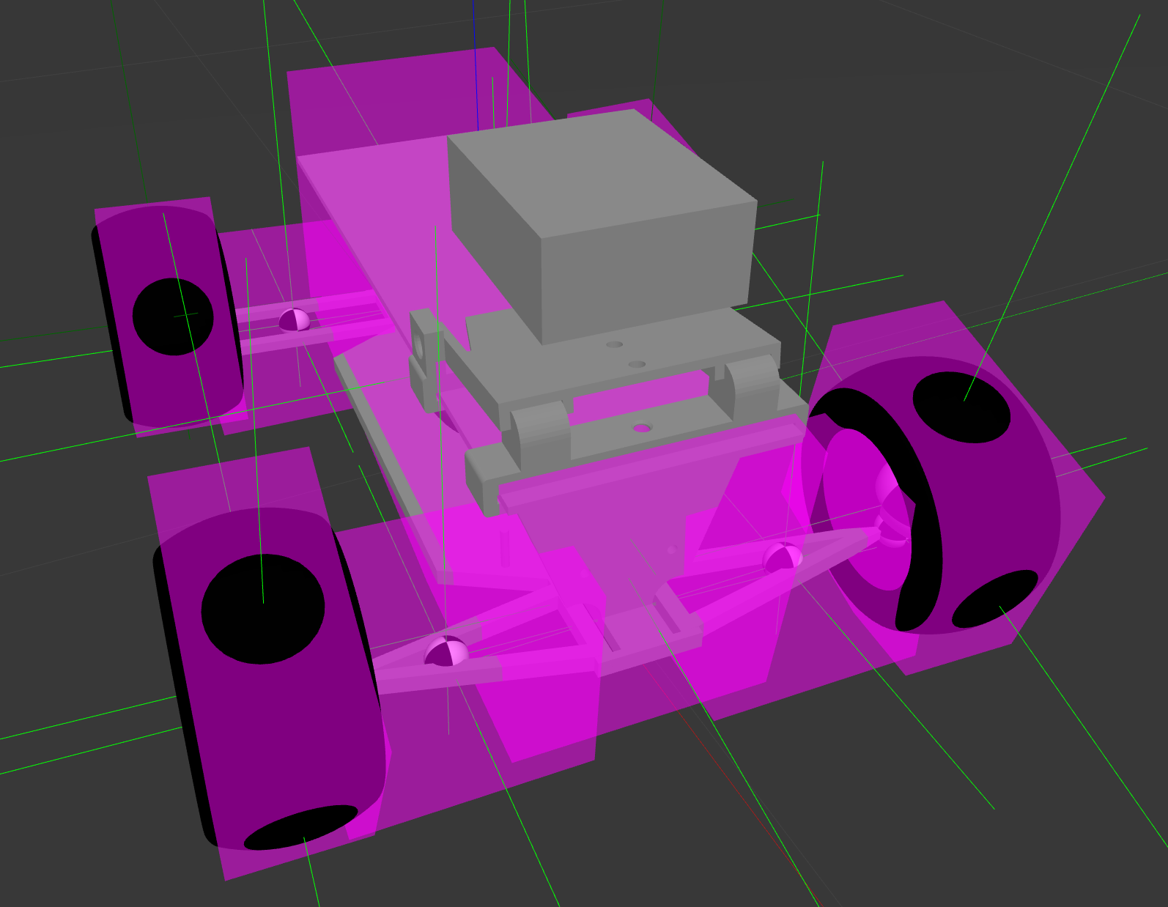
UGV Model Construction for use with Gazebo/ROS2
UGV in Gazebo
Inertial overlay
Source: Kenta Hirashima

Slide 34

YOLO ROS: Implementing YOLO as a ROS2 node
M. Bjelonic "YOLO ROS: Real-Time Object Detection for ROS", URL: https://github.com/leggedrobotics/darknet_ros, 2018.

Slide 35
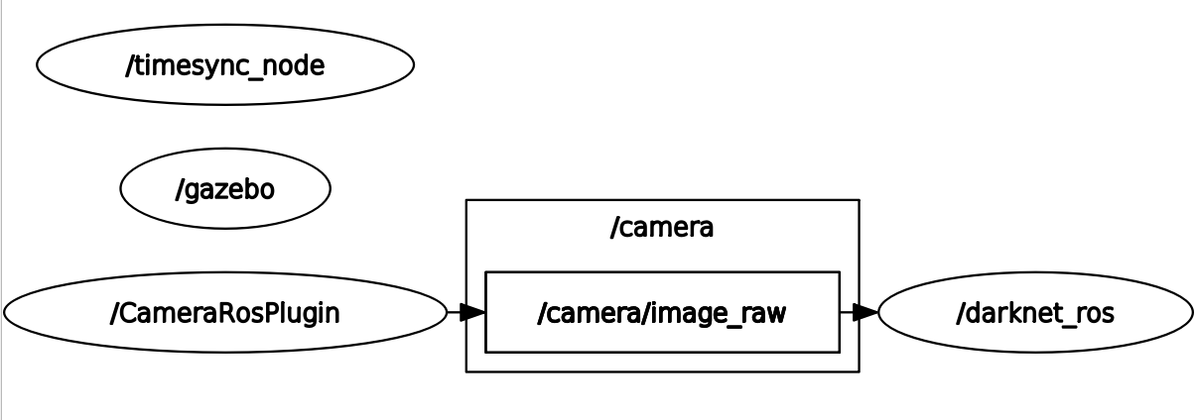
RQT Graph of Camera and YOLO ROS

Slide 36
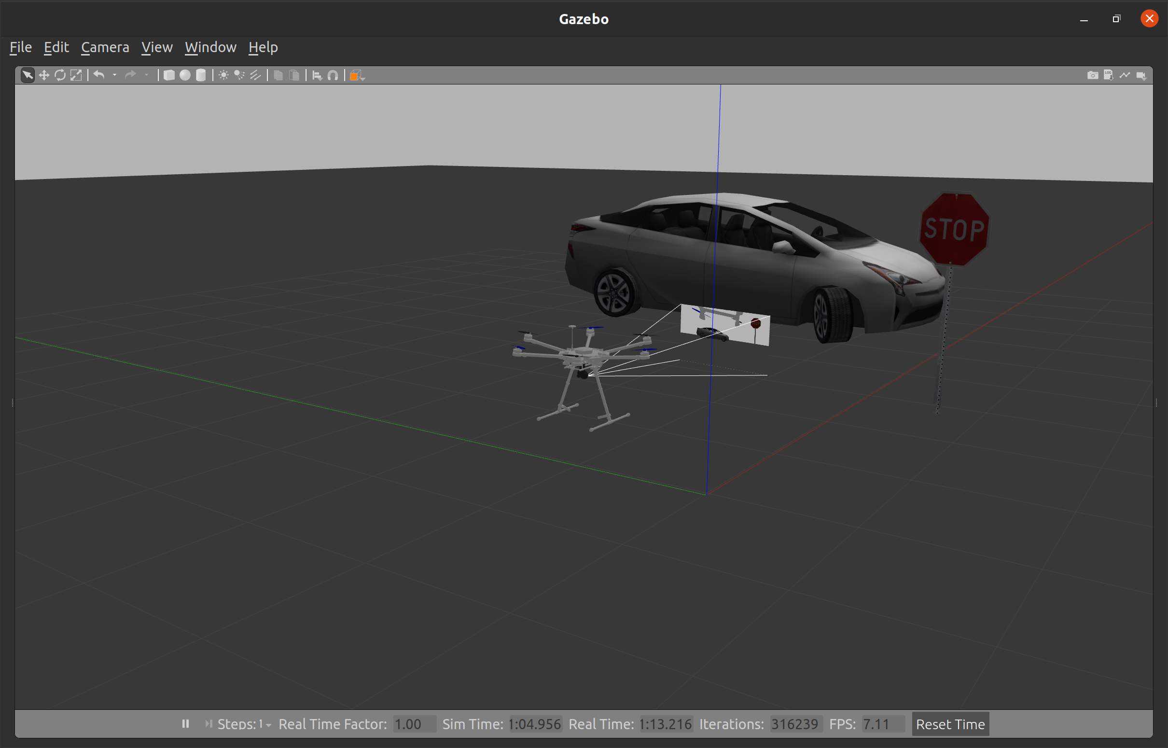
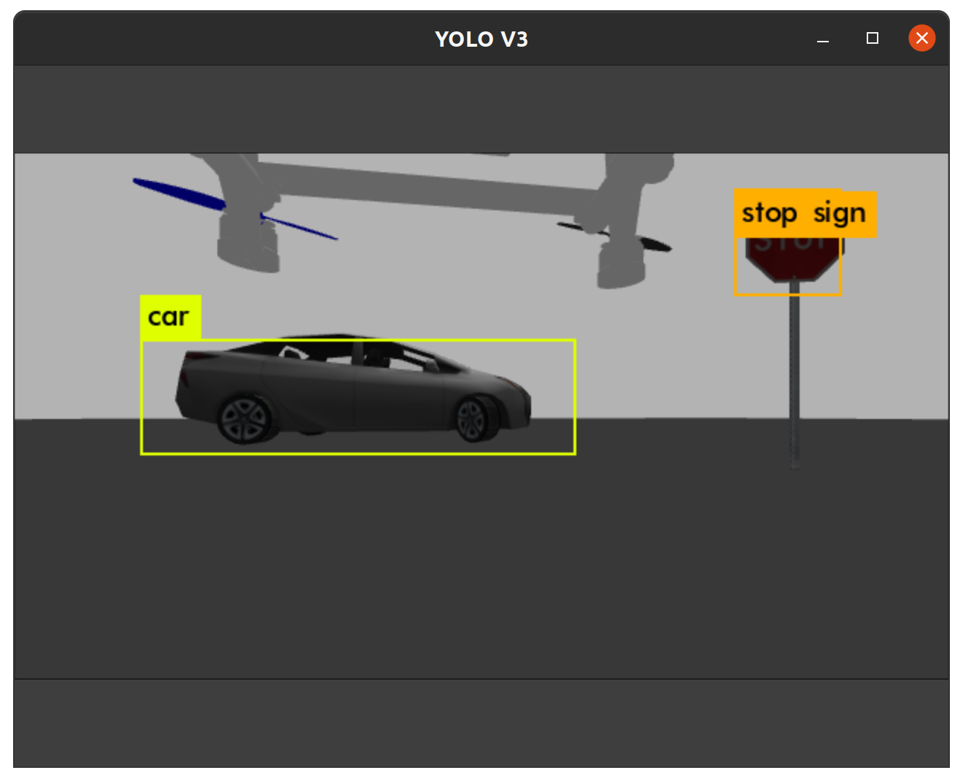
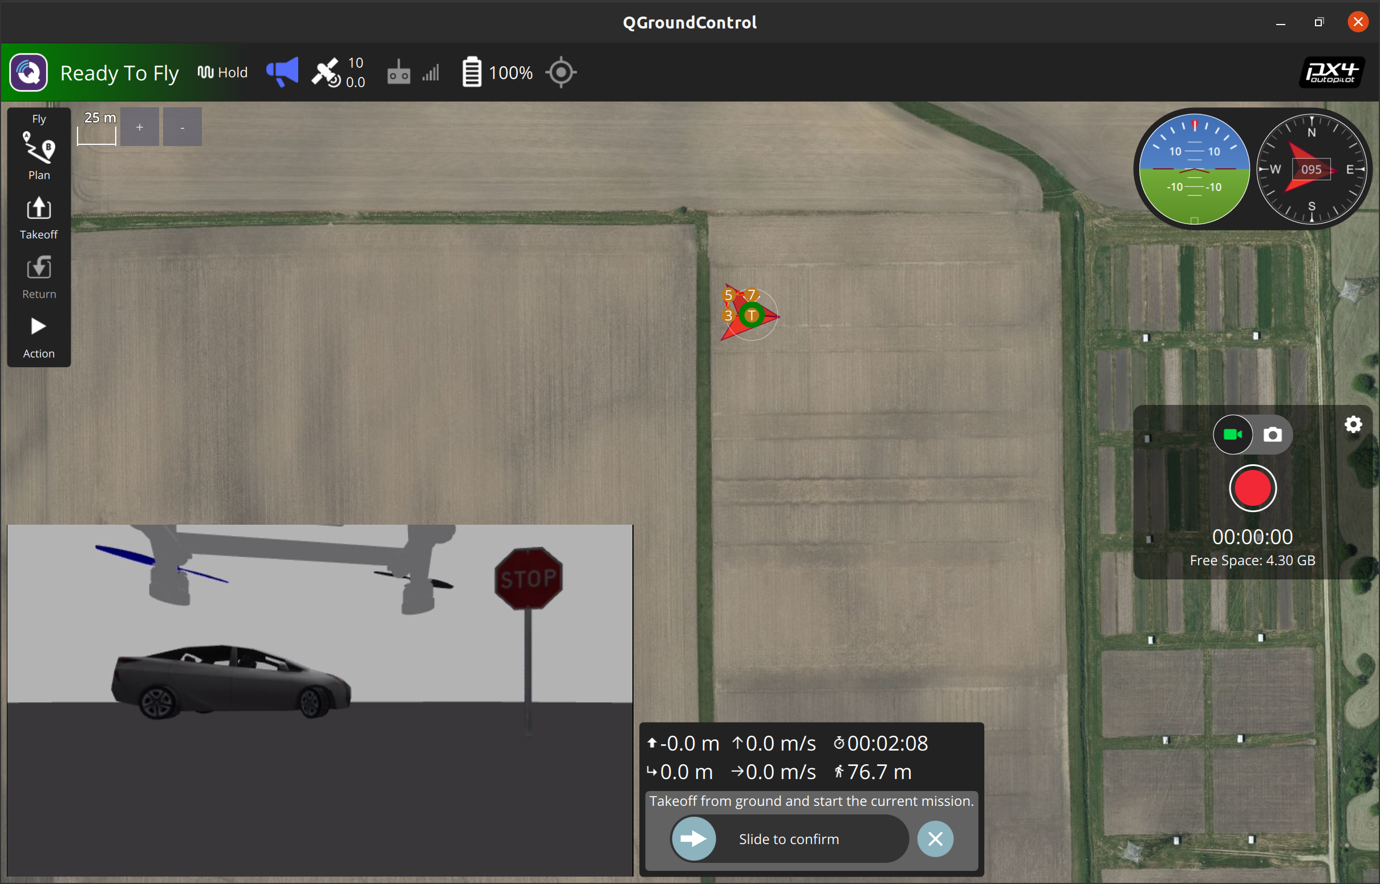
YOLO ROS detection with Gazebo models
Gazebo view
YOLO ROS
car: 57%, stop sign: 48%
QGC view

Slide 37
More results to come…

Slide 38
Conclusion: So what?

Slide 39
References

Slide 40
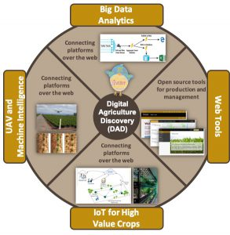



Acknowledgments

